Slide 1


Crime, Schools, & Populations
In the Austin Area
Presented by Jennifer Mayfield , Rehman Ali, Grecia White, & Kevin Thai Huy

Slide 2




We wanted to know how crime rates & school’s ratings by zip code were related in the Austin area.

Slide 3
We found zip codes as a common field in our various
data sets.
We initially found 41 zip codes in the Austin area.
Not all zip codes had schools and all three stages of primary education. We decided to focus on elementary schools since their ratings were more likely connected to only one zip code.
Our API calls had to request data by pages limited 50 schools per page. The free API calls were limited to 20 calls per day.
Our initial data set consisted of 7 combined pages and
dictionaries within dictionaries.
“Cleanup school data”

Slide 4
I used excel to format my first dataframe to see what my results would look like using pivot tables, vlookups, and filters.
We decided to use the data from schools that had the most data and ratings that correlated more closely to zip codes. This left us with 35 zip codes that was verified to my excel results.
We ended up using data from 132 school from out of 324 schools in Austin, TX.
Analysis Process for our school data.

Slide 5
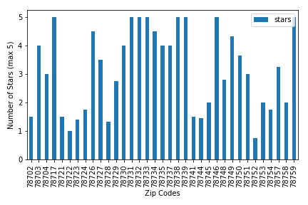
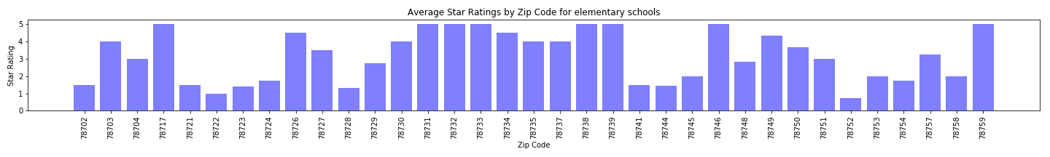
School Ratings by Zip Code
We experimented with different bar charts. It showed there were great disparities between schools in different zip codes throughout the city. There were more zip codes better than average. The overal average star rating was 2.7. 22 zip codes were above this average.

Slide 6
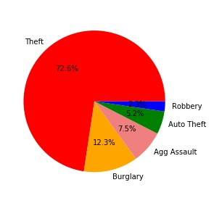
Theft
Theft by shoplifting
Theft from person
Theft of bicycle
Breach of computer security
Crime Categories in Austin
Aggravated Assault
•
^{Aggr}Tªh^{v}eªft^{t}a^{e}p^{d}peªa^{s}rs^{sa}to^{u}b^{lt}e^{f}thªe^{m}m^{/d}osªt^{t}c^{e}ommon
violence
crime in Austin.
Wehavemore misdemeanor crimes in
Burglary
Austin than felonies.
•
•
_{Burg}O_{l}u_{a}r_{r}d_{y}a_{o}ta_{n}do_{r}e_{e}s_{s}n_{id}o_{e}ts_{n}h_{c}o_{e}w if these offenses
_{Burgla}a_{r}re_{y} c_{n}o_{o}m_{n}m_{r}it_{e}te_{s}d_{id}m_{e}u_{n}lt_{c}ip_{e}le people or a
single offender.
Robbery
Auto Theft
Burglary of vehicle
Austin Area, Total Crime by Category

Slide 7

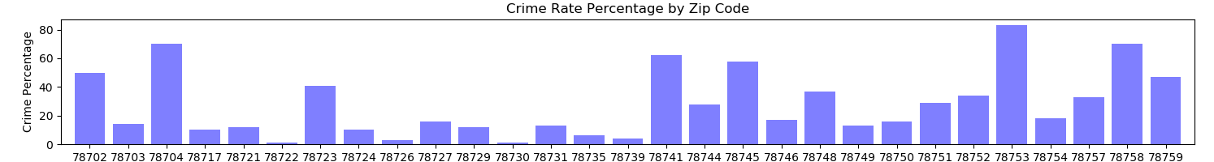
All sub categories of crime by zipcodes
78753 – North Lamar Area

Slide 8
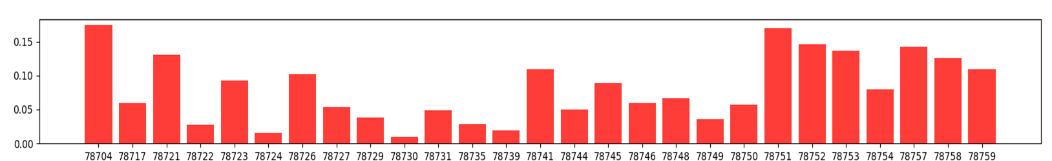
Total crime vs Population by Zipcode
Percentages = Crime/Population
78751 – Hyde Park, high 78752 – St Johns Area, high

Slide 9
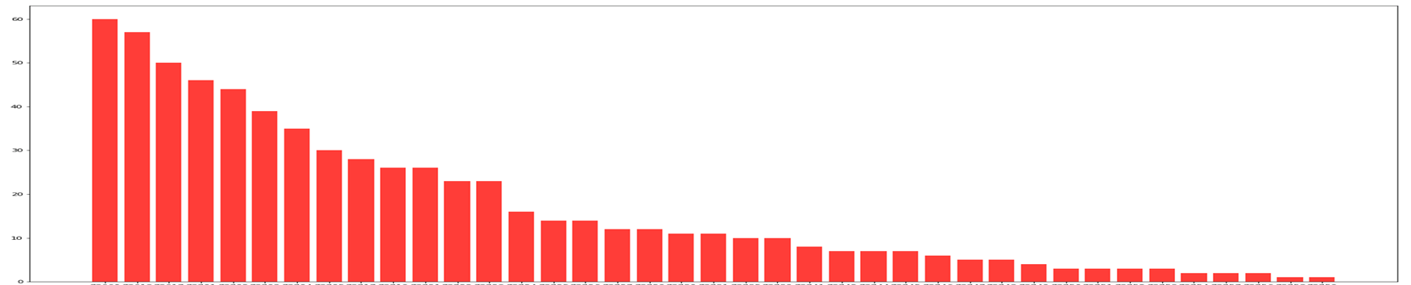
Just Theft
by Zip Code
2017
Where you live in Austin can increase you chances being involved or witness to a crime.
Zip codes with the highest theft
78660- Pflugerville
78613 -Cedar Park
78617- De Valle

Slide 10
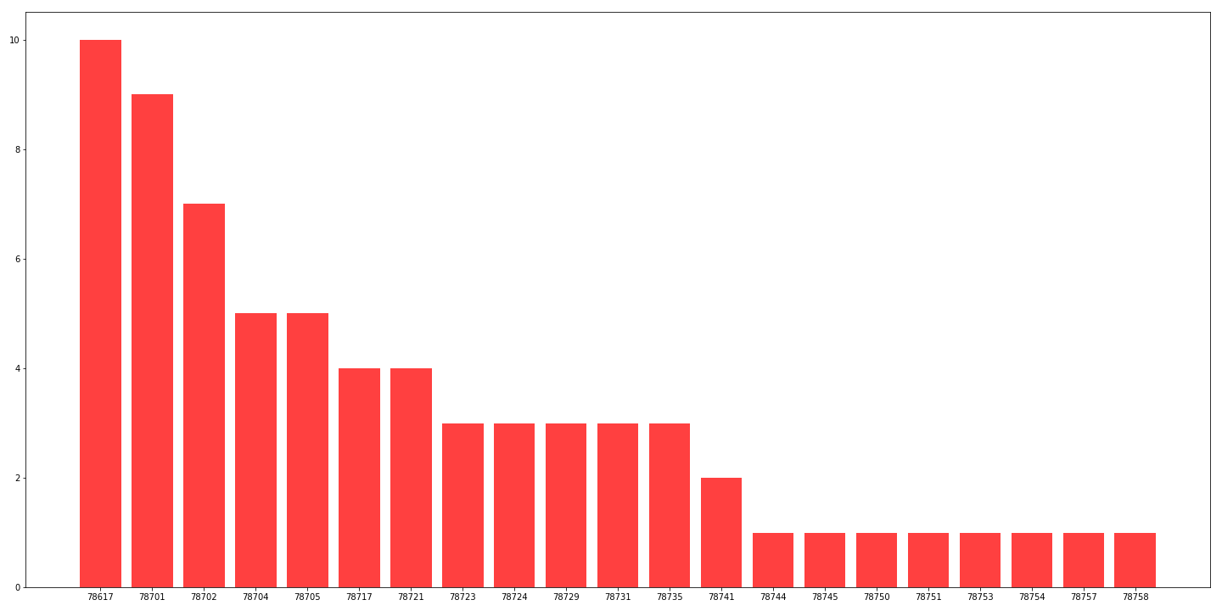
Just Aggravated Assault by zip code
78617- Del Valle, high
78701- Downtown, high
78702- East Austin Chicon and 7th, high
Aggravated assault by
zip code. Where you live in Austin matters whether your more at risk for aggravated assault.

Slide 11

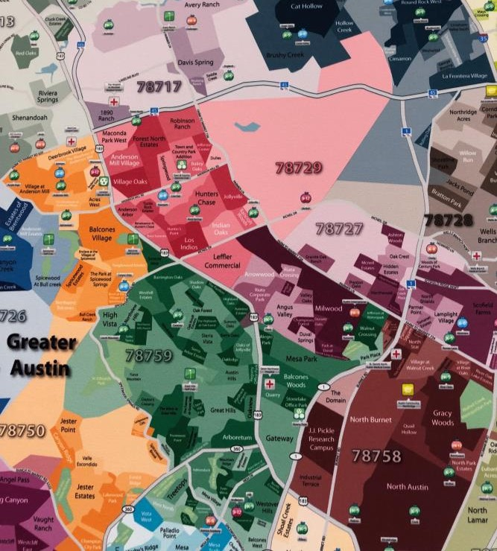
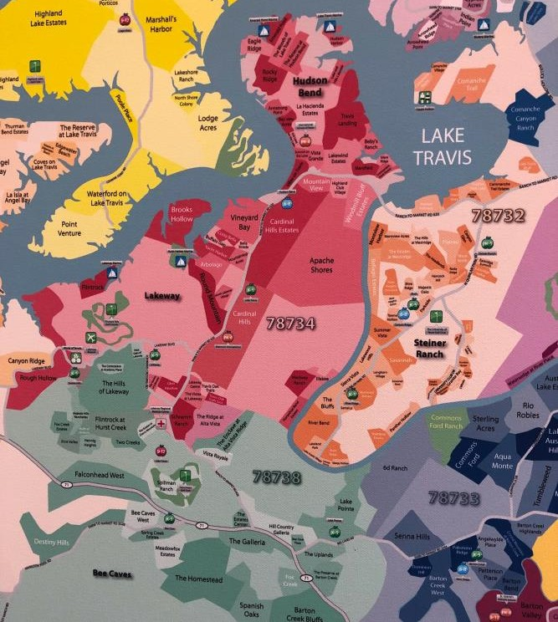
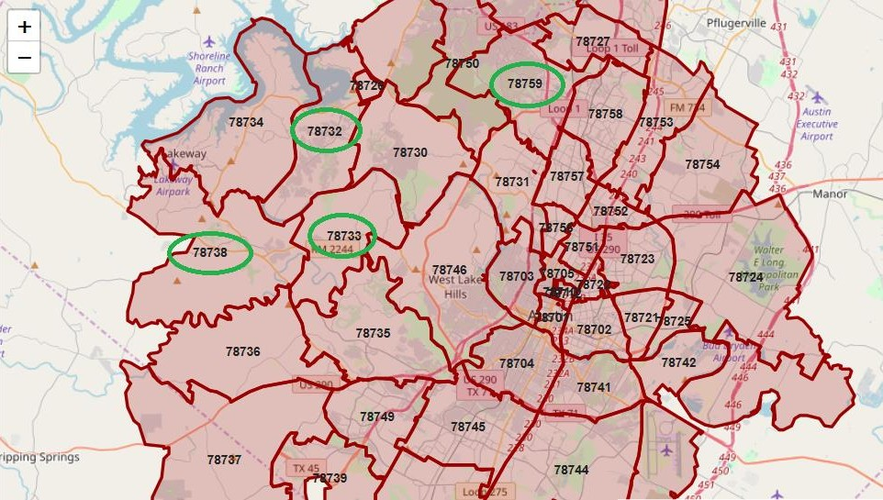
Conclusion
There is a strong correlation between crime rates and school ratings in Austin.
There are distinct zip codes where you see
highly rated schools and low or no crime rates.
There are limitations on data and what they can show.
The best zip codes with low crime rates and 5
star elementary schools are 78732, 78733,78738,
& 78759.
There are many crimes not reported or don’t
result in conviction and are not recorded.
Test scores are only one factor that can define a school and how we rate a school.

